Slide 1
Band structure information from soft x-ray spectroscopy
Andrew Preston
andrew@preston.co.nz

Slide 2
Materials World Network
Spintronics group
Ben Ruck, Joe Trodahl
Electronic structure group
Walter Lambrecht
Novel Materials Lab
Kevin Smith

Slide 3
NML at BU
Kevin Smith
Louis Piper
Sang Wan Cho
Alex DeMasi

Slide 4
NML at BU
Novel materials
Nitrides: Rare-earth nitrides, III-V
Oxides: TCO, SOFC, low dimensional
Organics
X-ray spectroscopy
Absorption (XAS)
Emission (XES)
Resonant emission (RXES, RIXS)
Photoemission (XPS)
Angle resolved photoemission (ARPES)

Slide 5
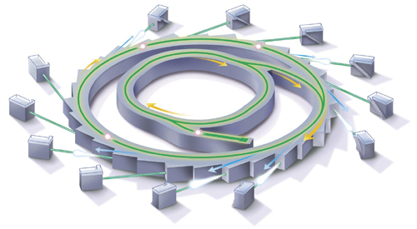
NML at BU
Synchrotron based
National Synchrotron Light Source – X1B
Advanced Light Source – BL7, BL12
MAXlab – 5II

Slide 6
Spectroscopy

Slide 7
Spectroscopy

Slide 8
X-ray absorption (XAS)
Empty
E_{f}
Filled

Slide 9
X-ray absorption (XAS)
Empty
E_{f}
Filled

Slide 10
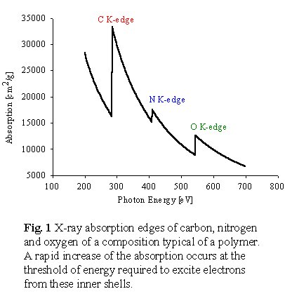
Site selectivity

Slide 11
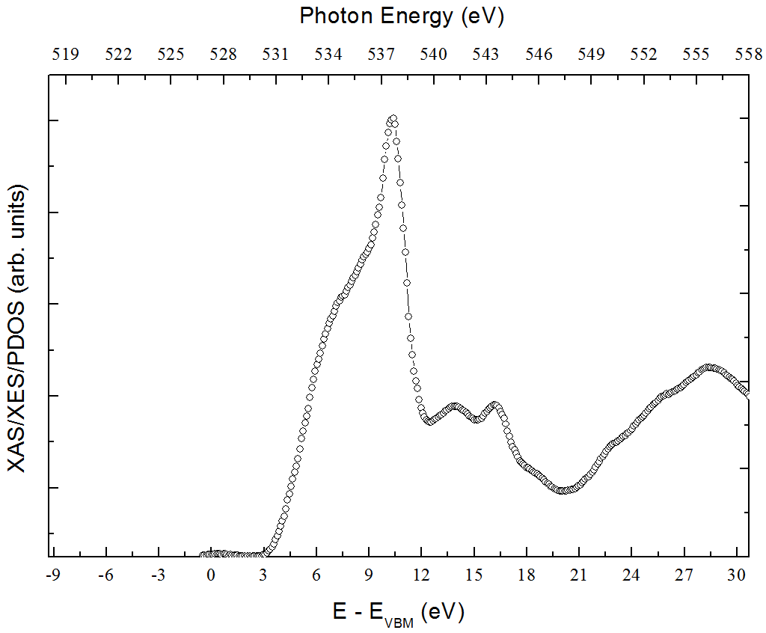
Typical XAS

Slide 12
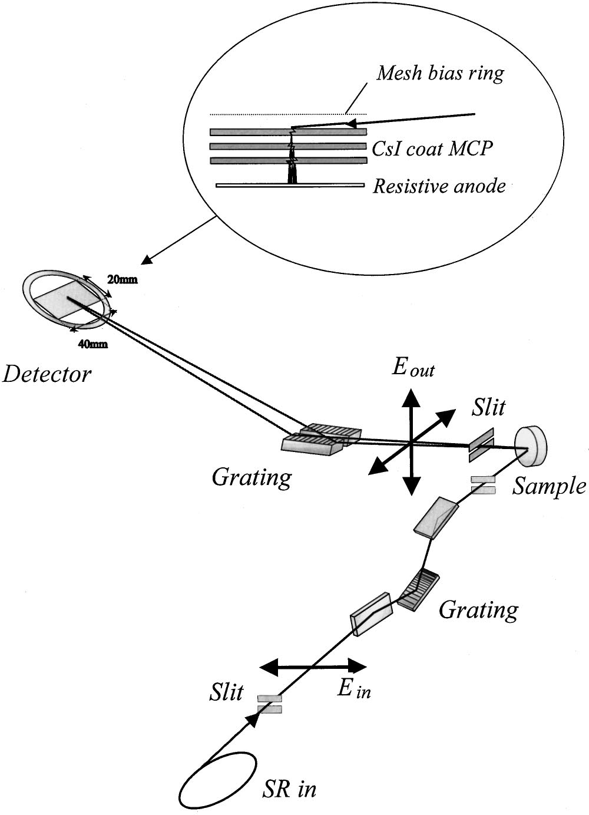
XAS
Curtain!
Kotani, Shin
Rev. Mod. Phys. 73, 203 (2001)

Slide 13
ZnO XAS

Slide 14

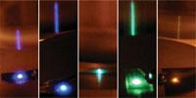
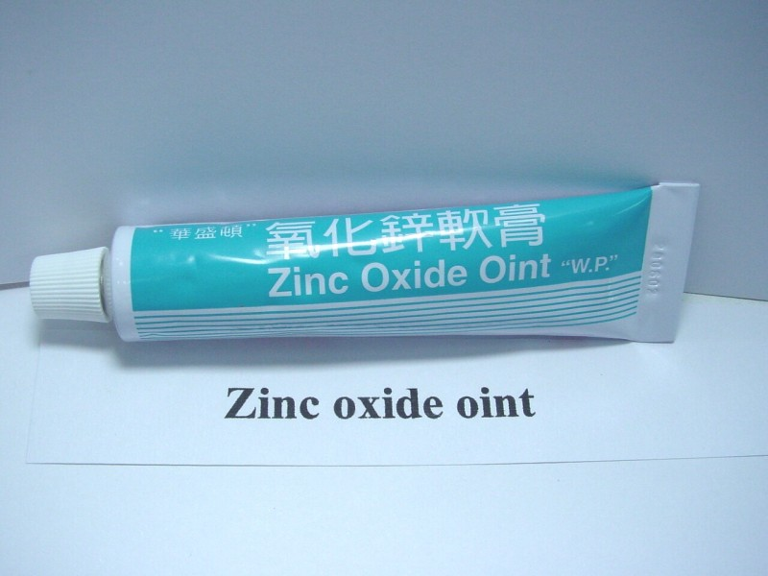
Zinc oxide

Slide 15
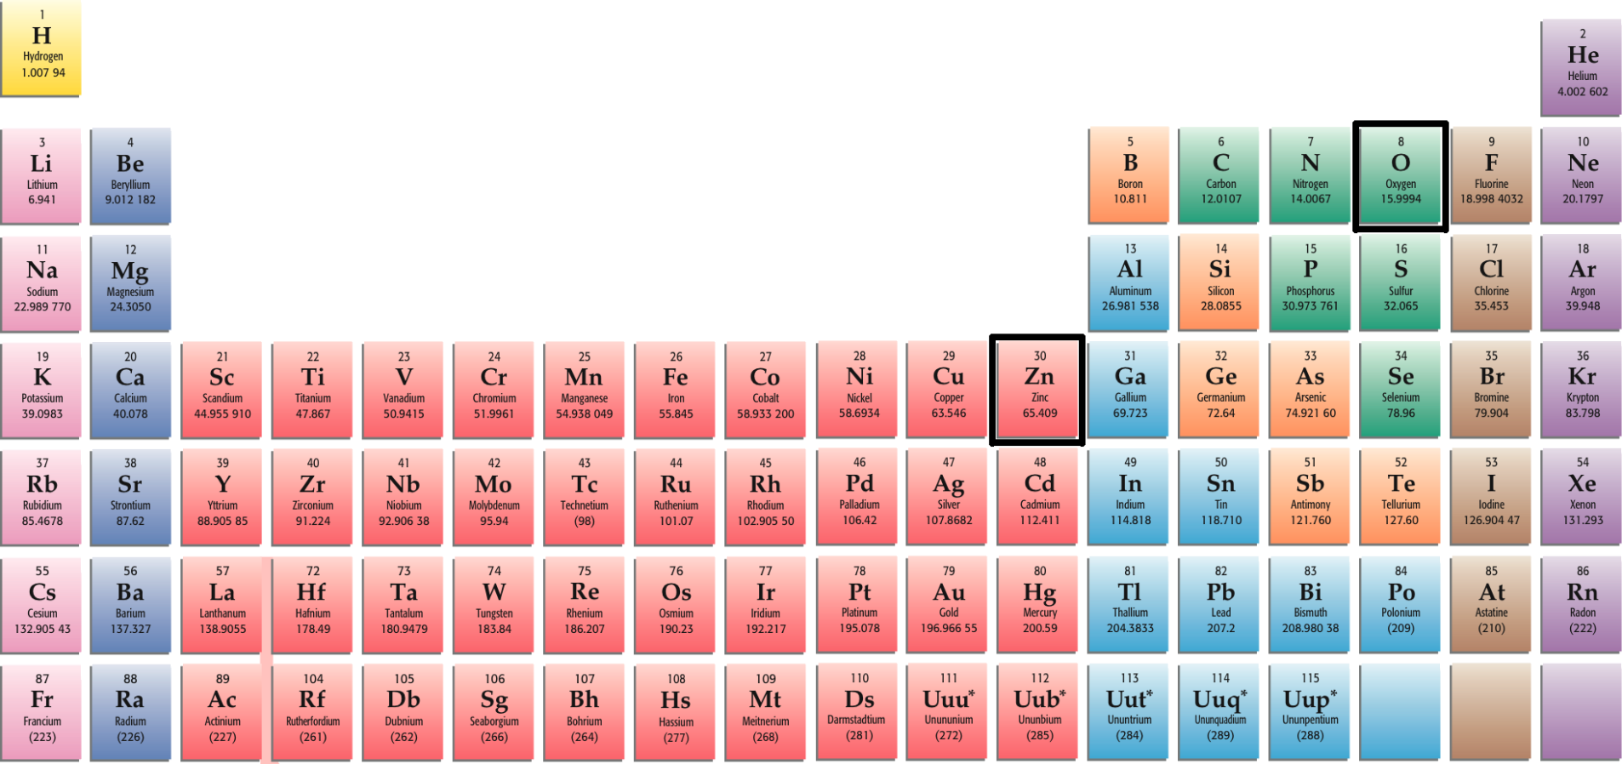
Zinc oxide
Zn = [Ar]3d¹⁰4s² O = [He]2s²2p⁴

Slide 16
ZnO electronic structure
Density functional theory
HSE03 XC functional
GW correction
Essential for correctly locating the Zn 3d electrons, bandgap

Slide 17
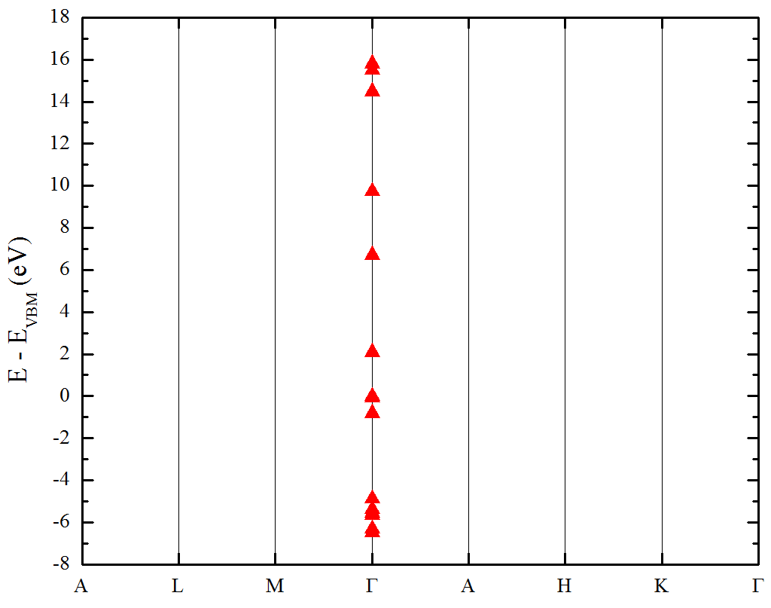
ZnO electronic structure

Slide 18
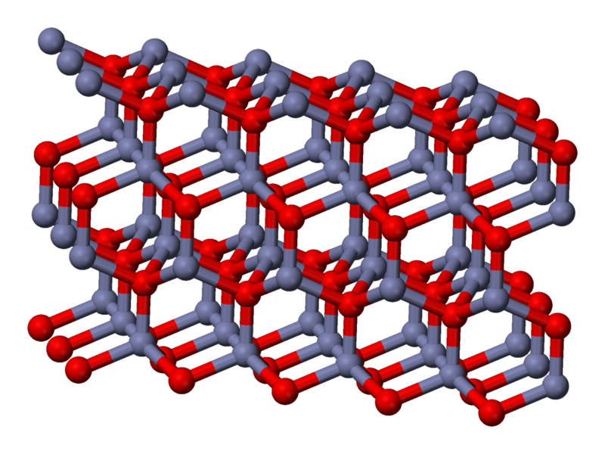
Zinc oxide

Slide 19
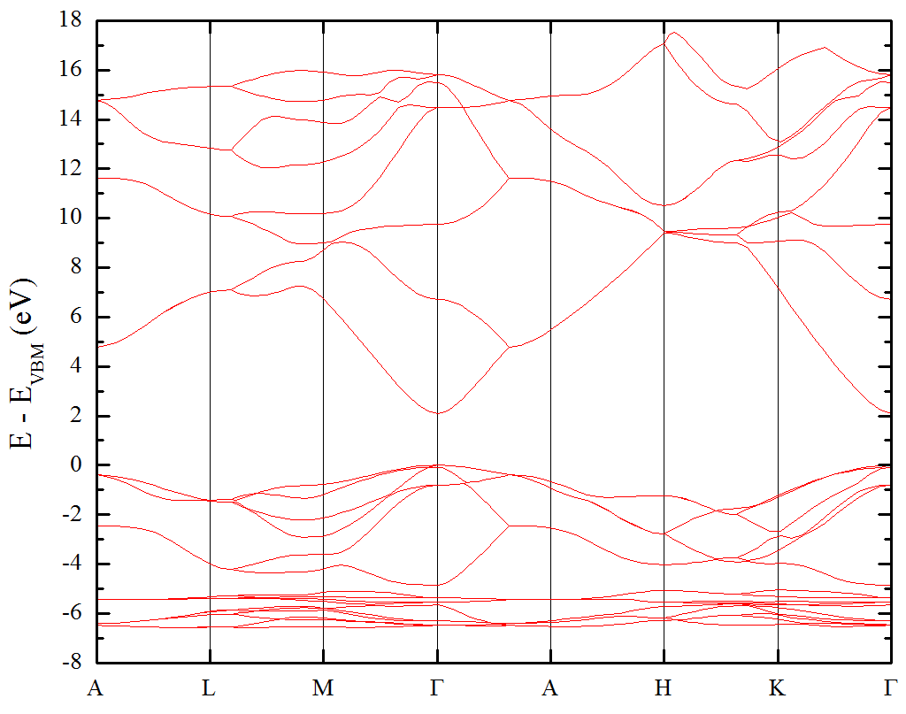
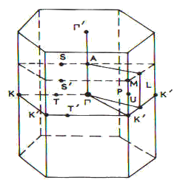
ZnO electronic structure

Slide 20
Dipole approximation
Orbital selection
Δl = ±1
s -> p

Slide 21
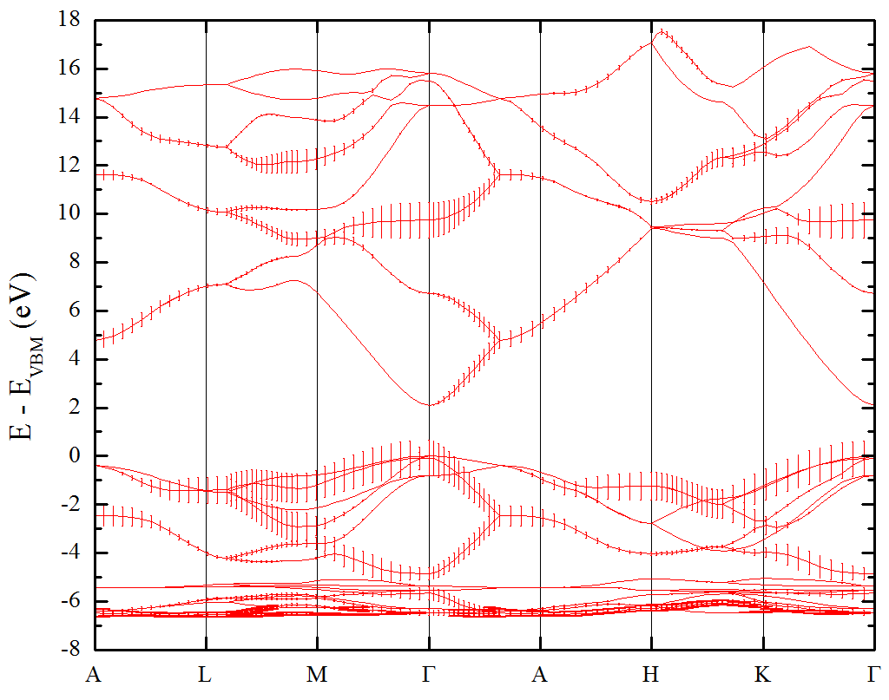
ZnO electronic structure

Slide 22
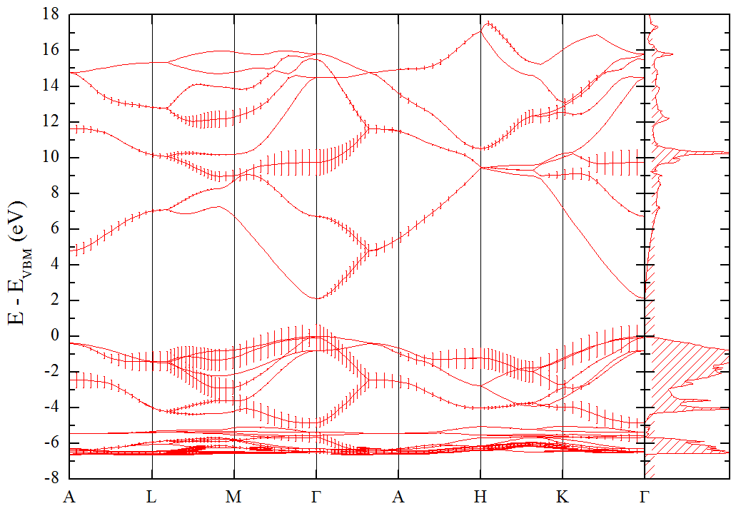
ZnO electronic structure

Slide 23
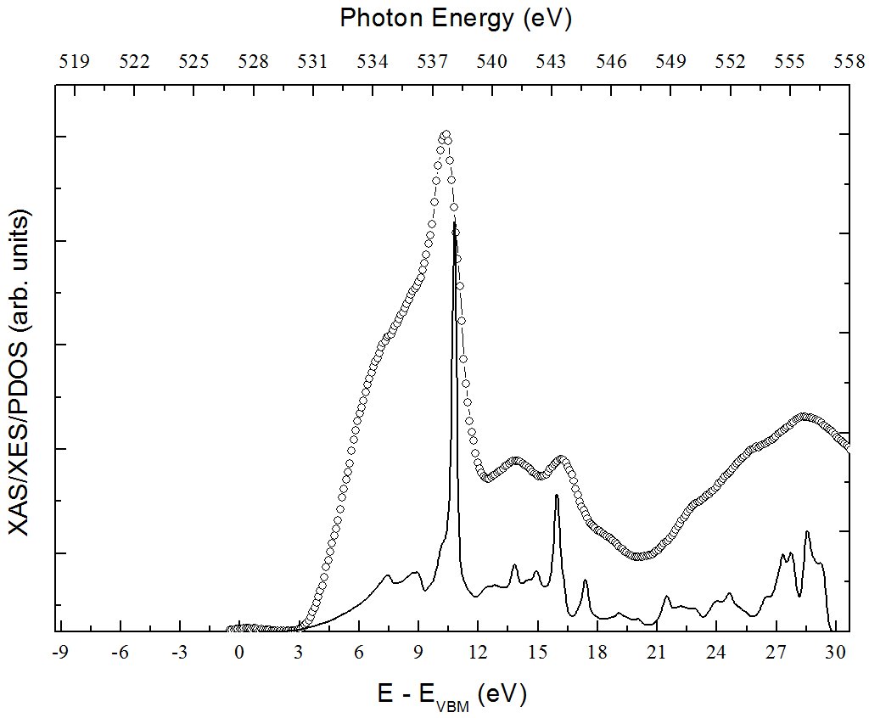
ZnO XAS

Slide 24
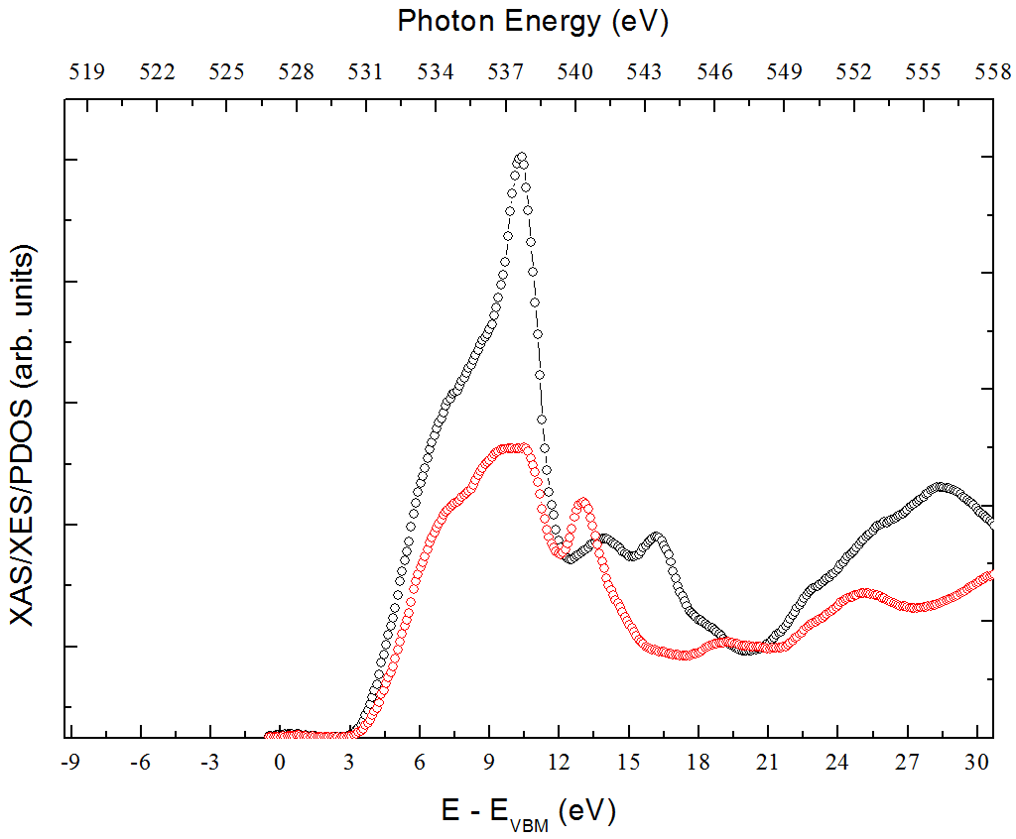
ZnO anisotropy

Slide 25
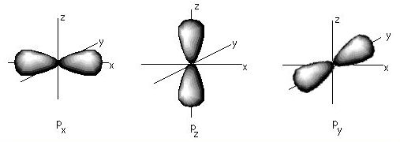
ZnO anisotropy
O p orbitals
ZnO crystal

Slide 26
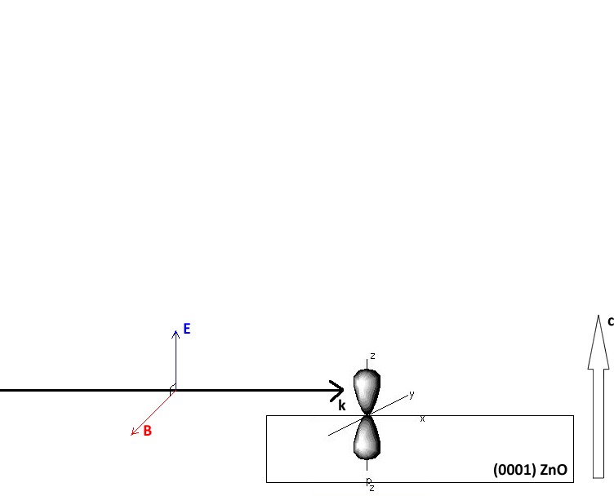
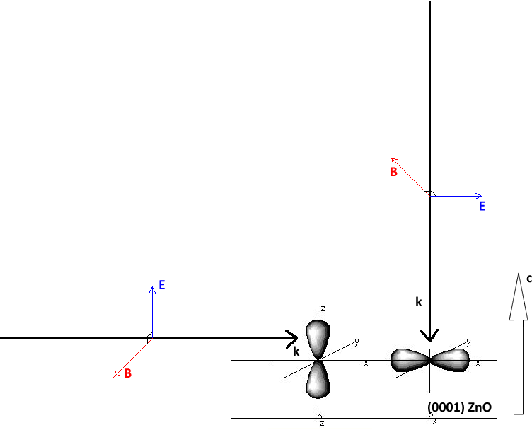
Orbital selection

Slide 27
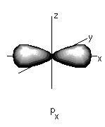
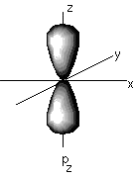
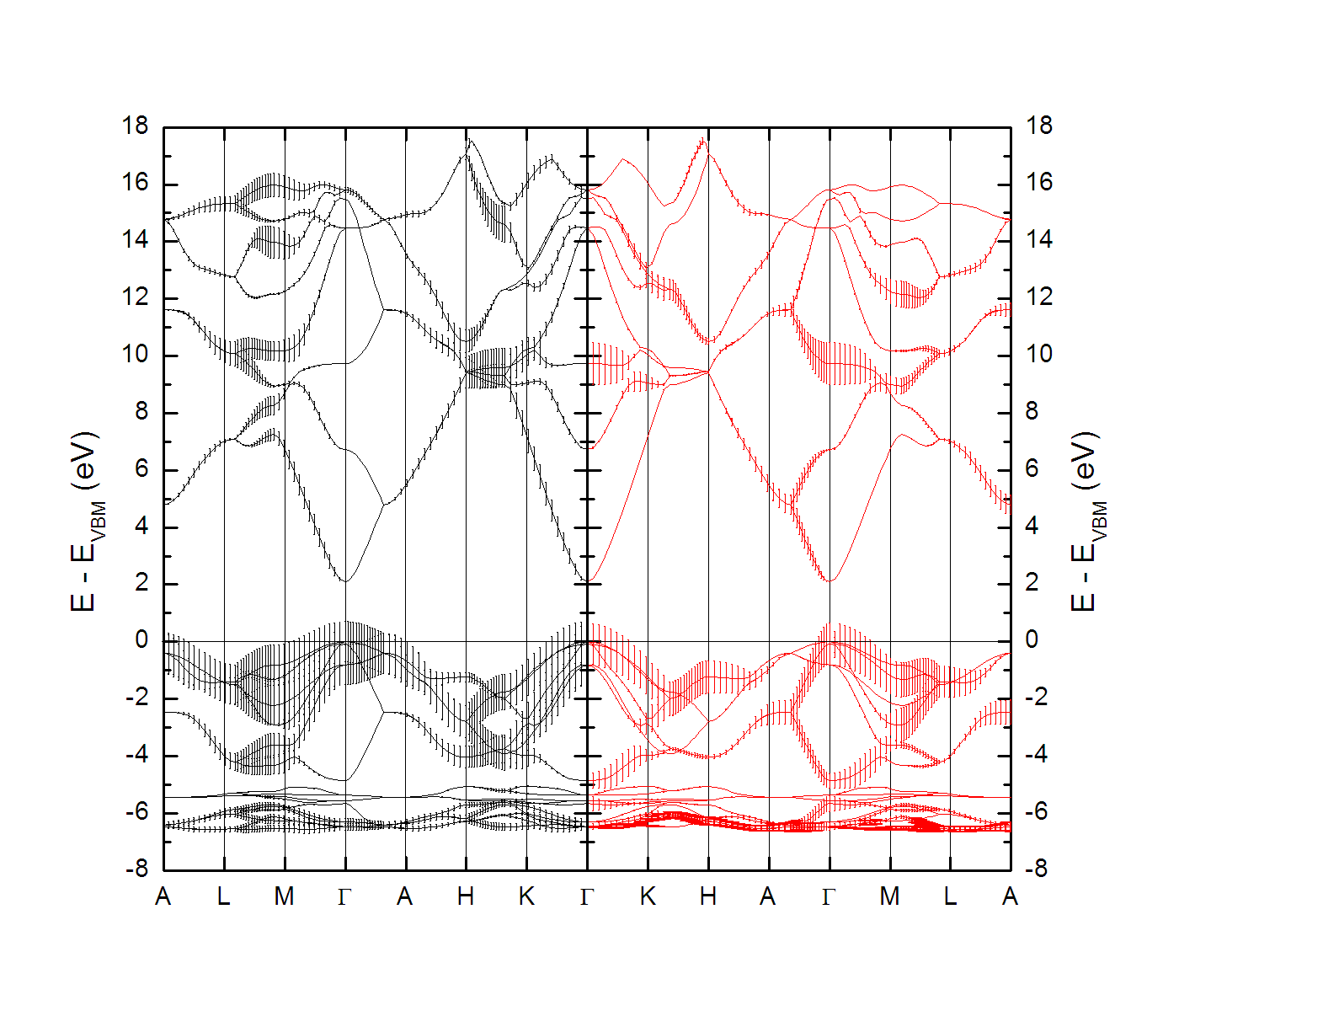
ZnO anisotropy

Slide 28
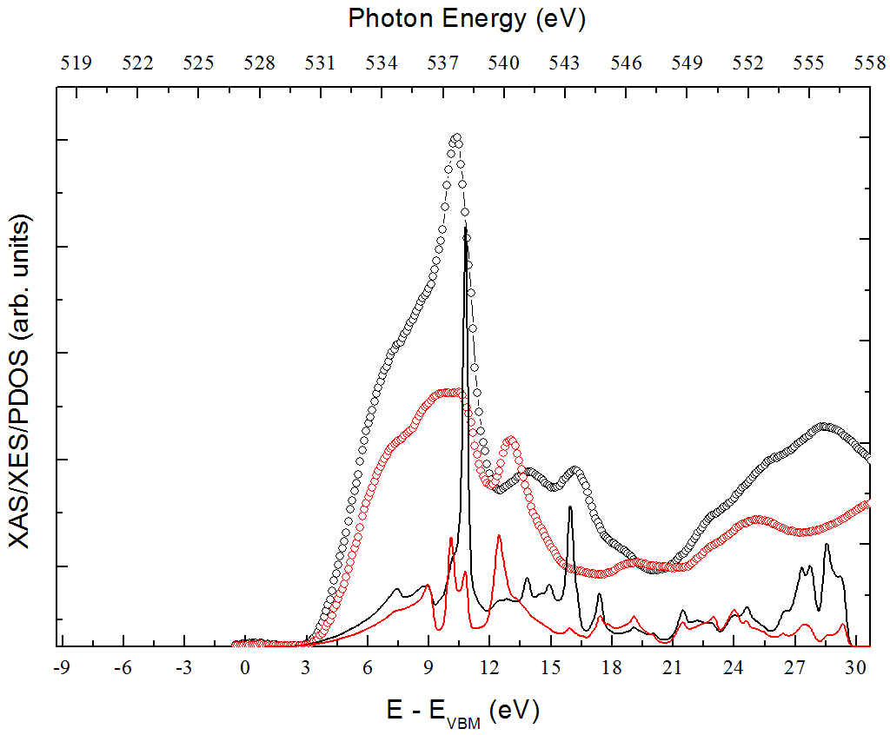
ZnO XAS

Slide 29
X-ray emission (XES)
Empty
E_{f}
Filled

Slide 30
XES
Curtain!
Kotani, Shin
Rev. Mod. Phys. 73, 203 (2001)

Slide 31
XES
Kotani, Shin
Rev. Mod. Phys. 73, 203 (2001)

Slide 32
Dipole approximation
Orbital selection
Δl = ±1
p -> s

Slide 33
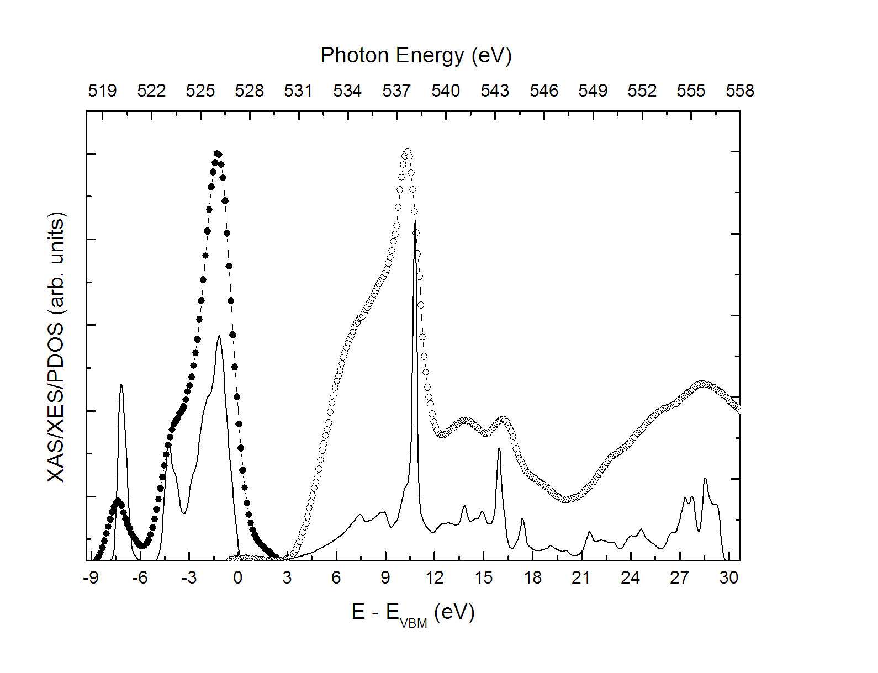
ZnO XAS and XES

Slide 34
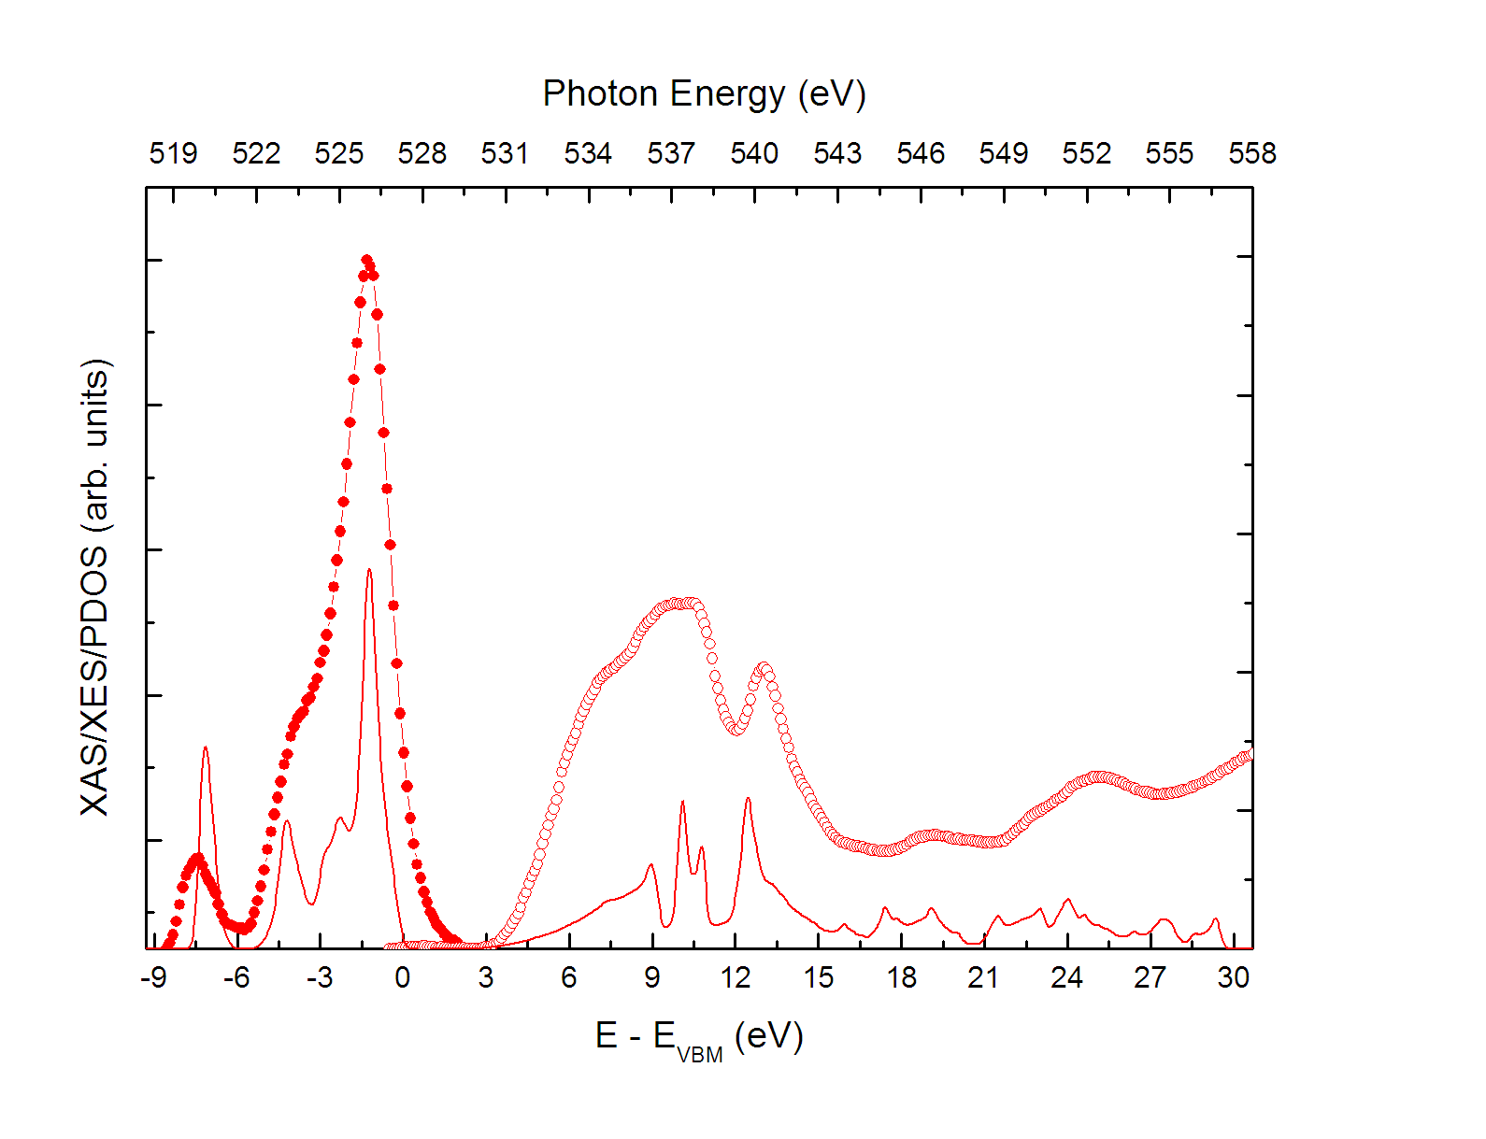
ZnO XAS and XES

Slide 35
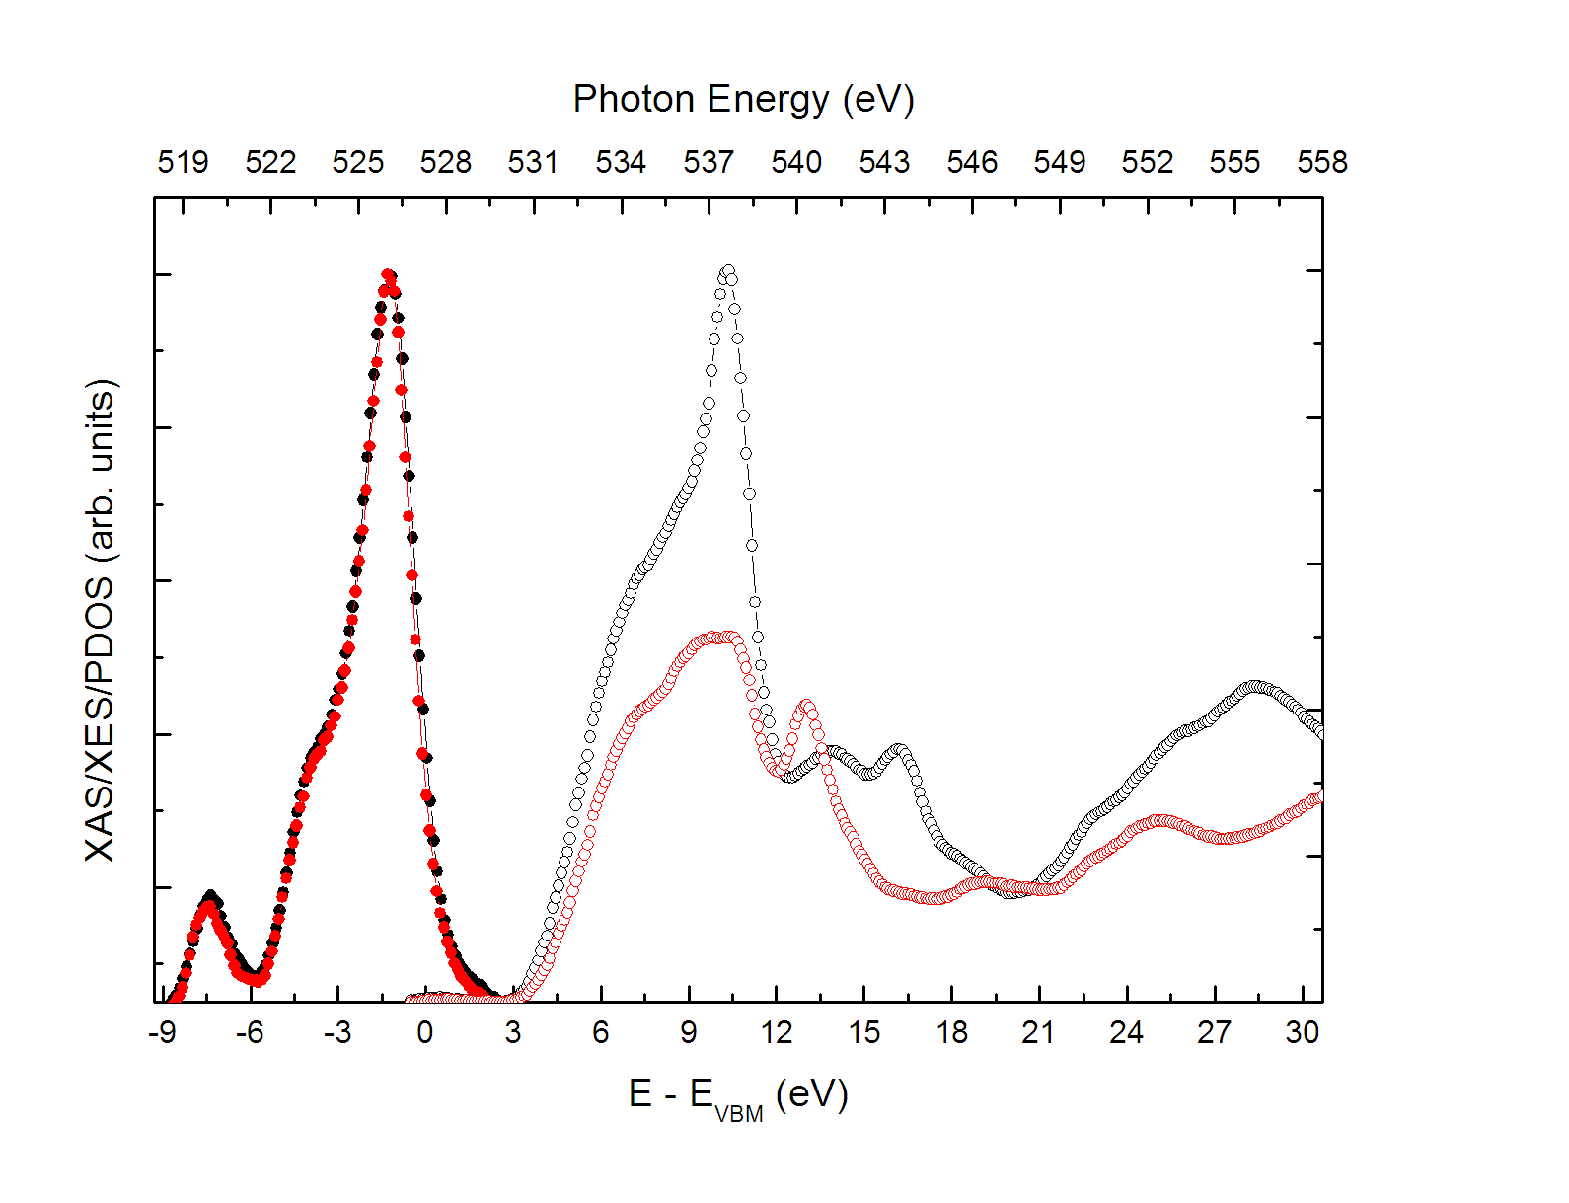
ZnO XAS and XES

Slide 36
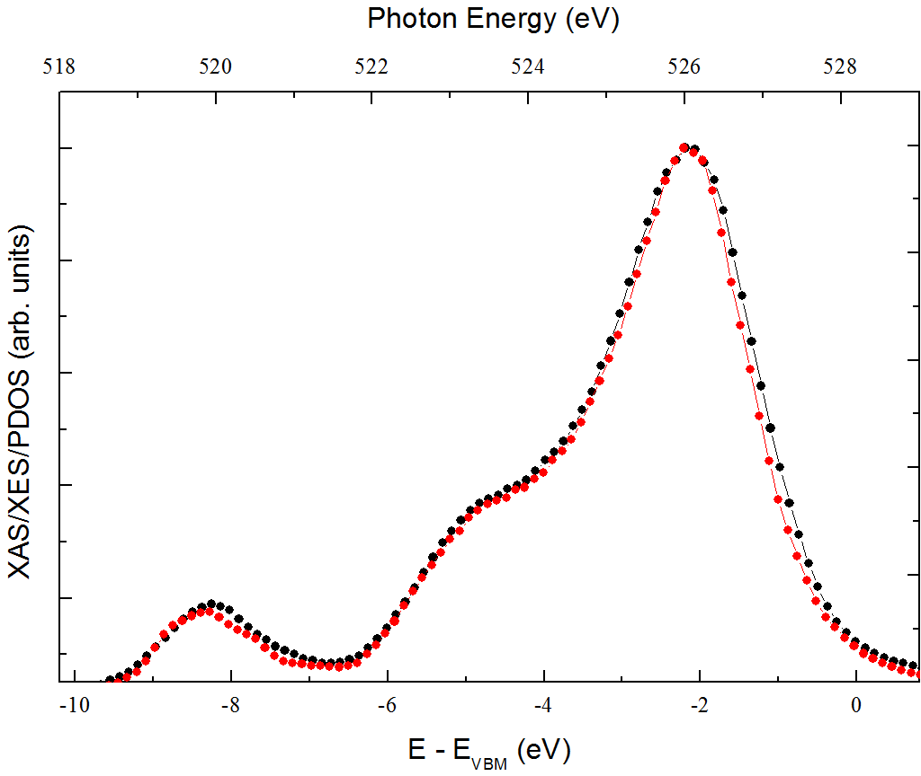
XES anisotropy?

Slide 37
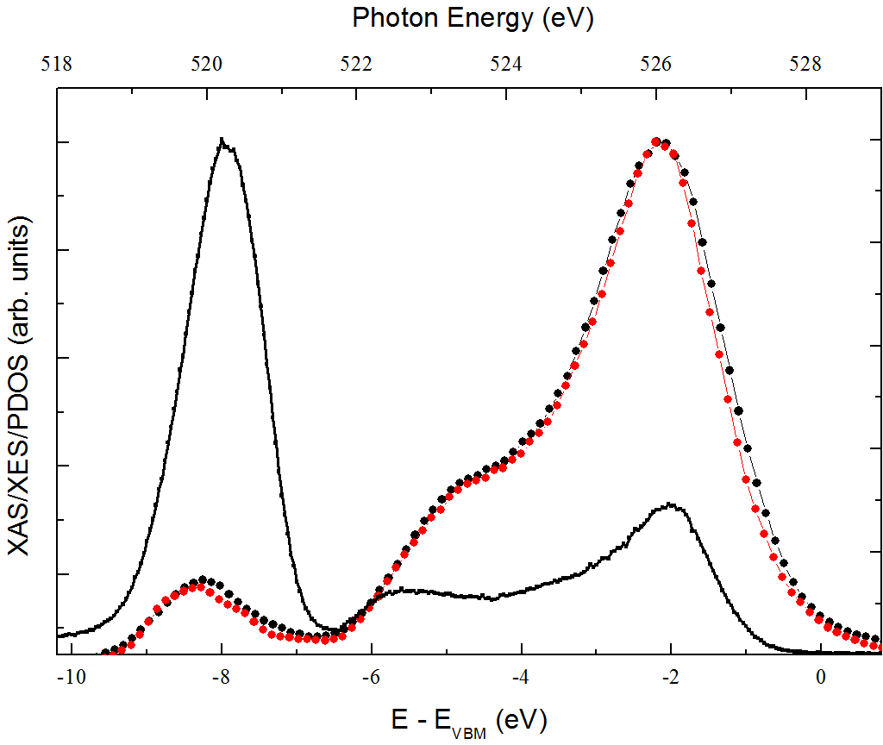
XES and XPS

Slide 38
XAS and XES
Optical processes (photon in/photon out)
Magnetic fields
Insulators
Dirty surfaces
Capping layers
Advantages over photoemission in some domains

Slide 39
Selection rules
Site selection
Orbital selection
Dipole selection rule (conservation of angular momentum)
Orbital selection 2
Linear polarization + crystalline anisotropy
Dispersion?

Slide 40
Resonant x-ray emission (RXES)
Empty
E_{f}
Filled

Slide 41
RXES
Kramers-Heisenberg
Coherent 2nd order process
XAS from |i> to |m>, followed by XES from |m> to |f>
Selection rule: conservation of crystal momentum!

Slide 42
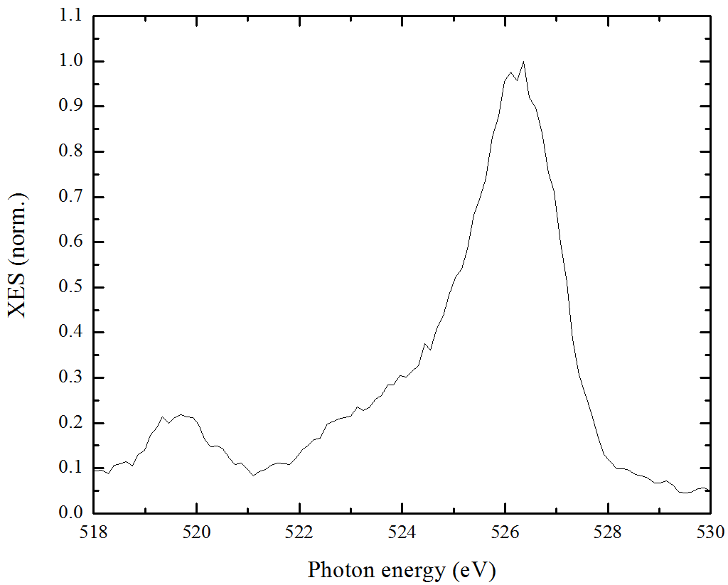
RXES = coherent and incoherent XES

Slide 43
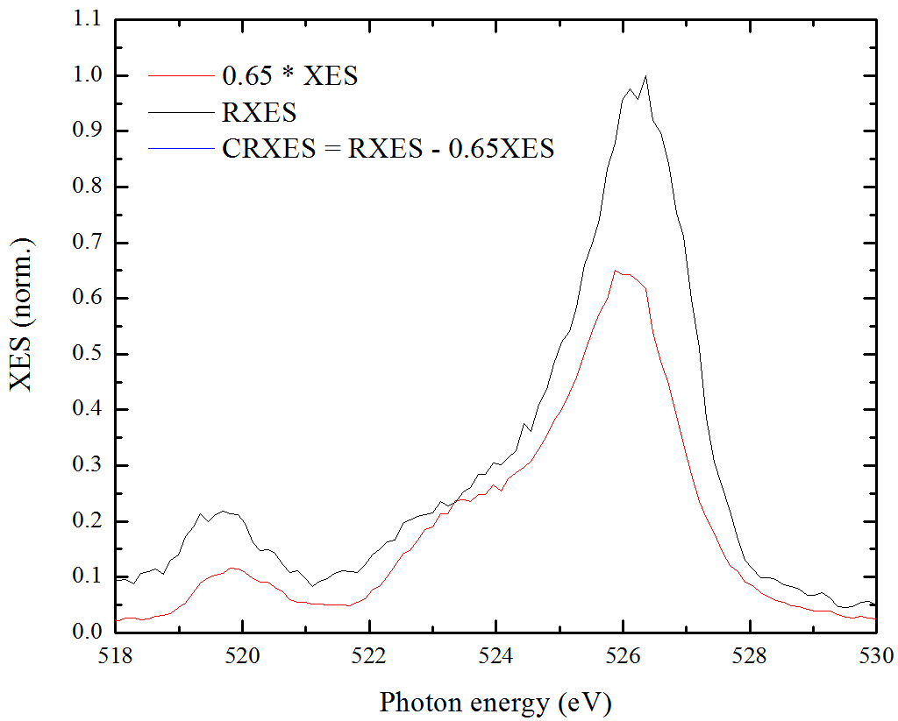
RXES

Slide 44
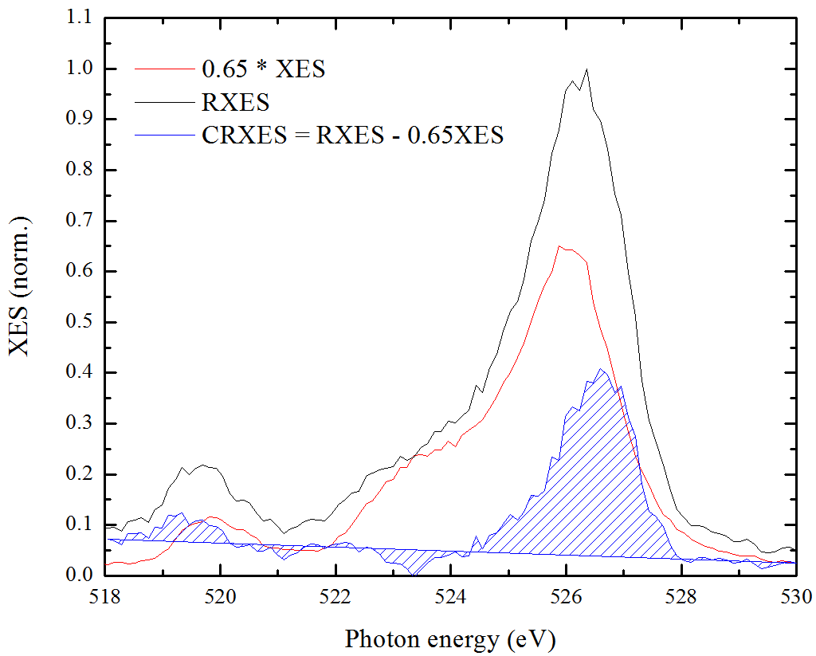
RXES

Slide 45
RXES
Kotani, Shin
Rev. Mod. Phys. 73, 203 (2001)

Slide 46
ZnO anisotropy

Slide 47
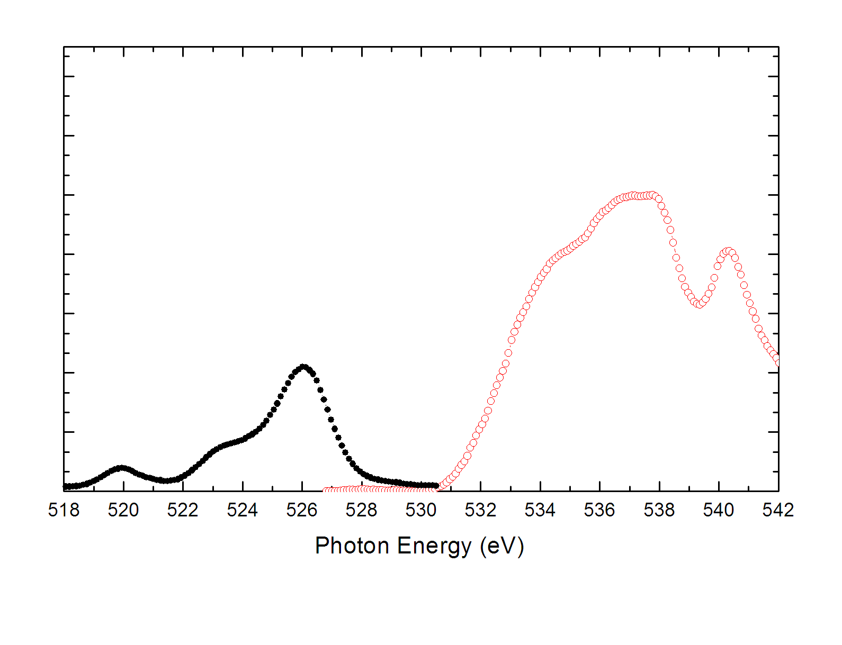
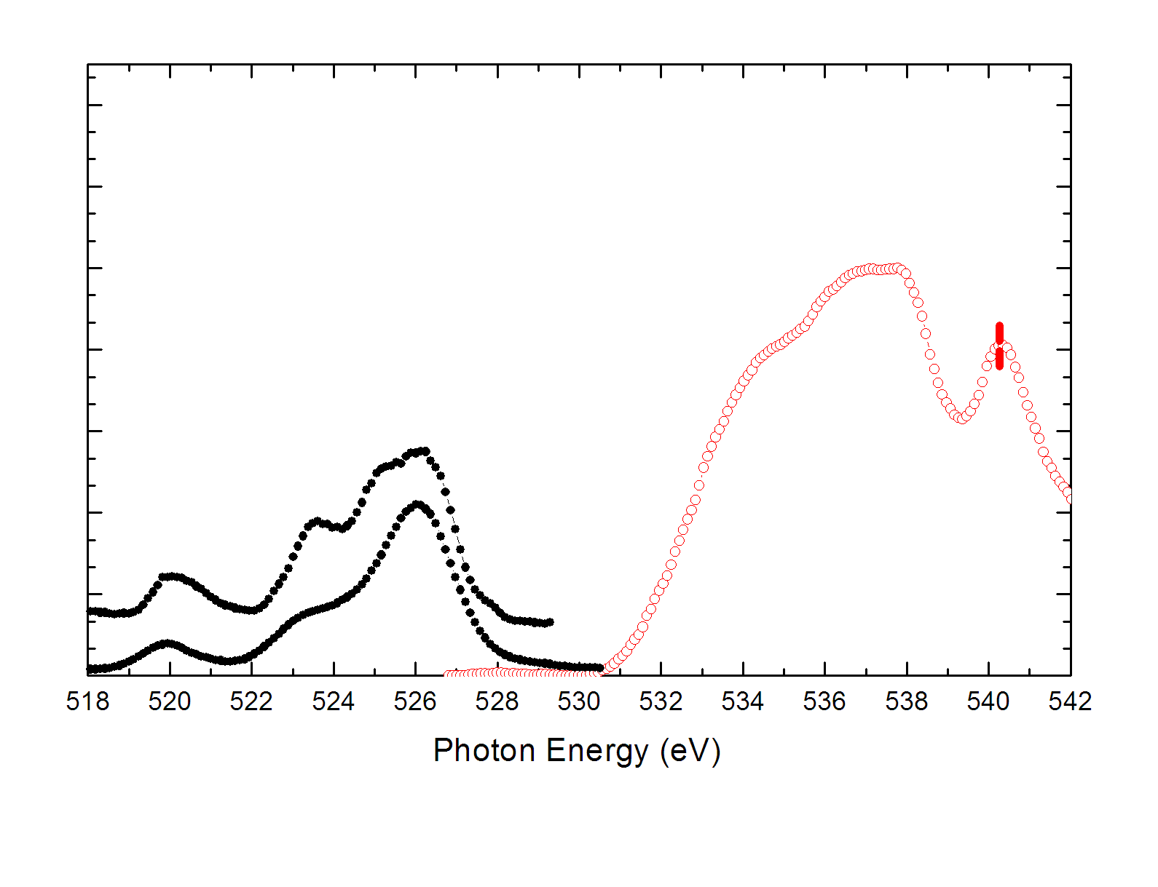
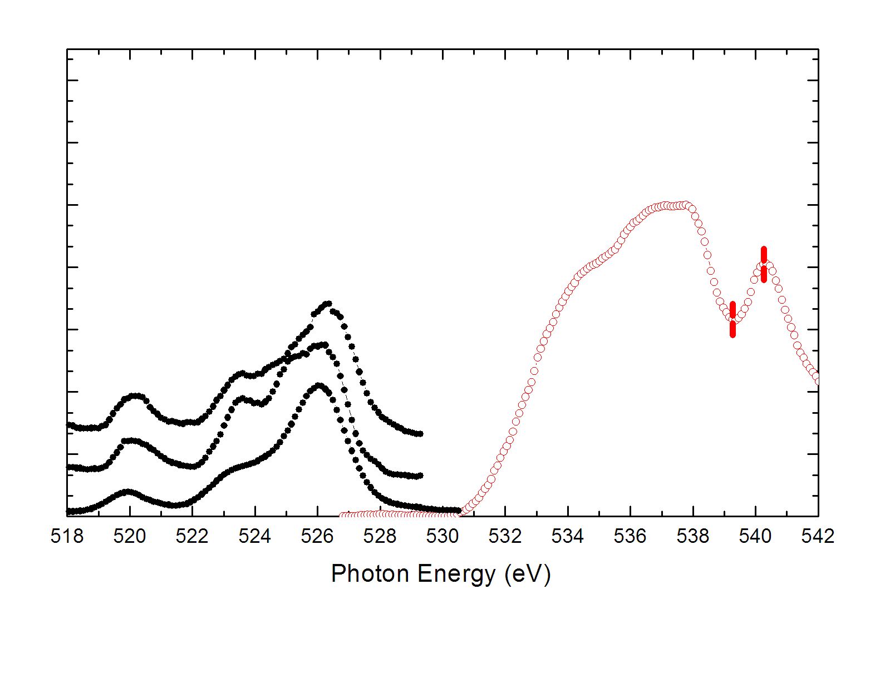
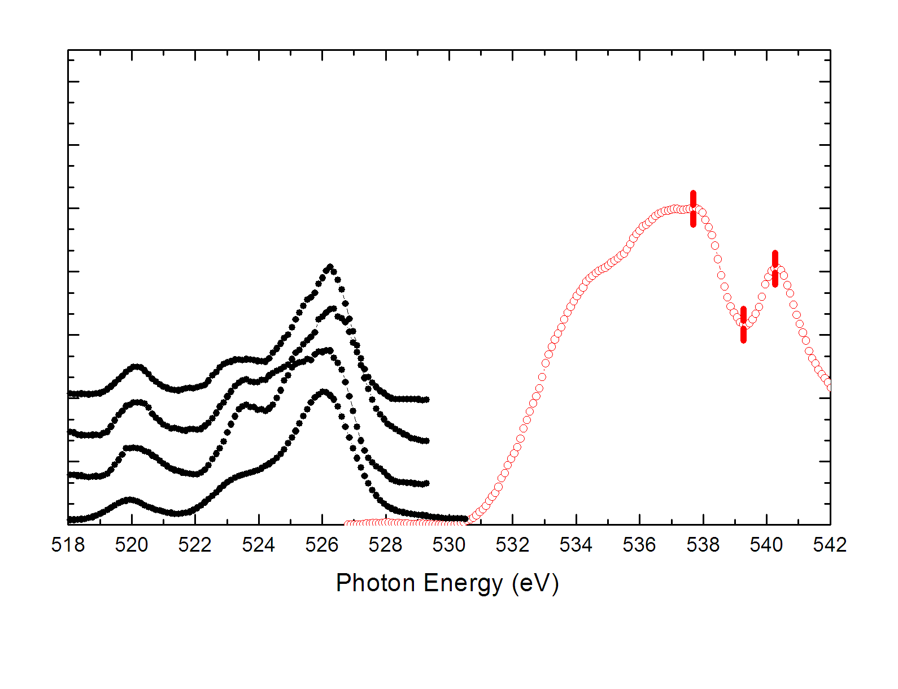
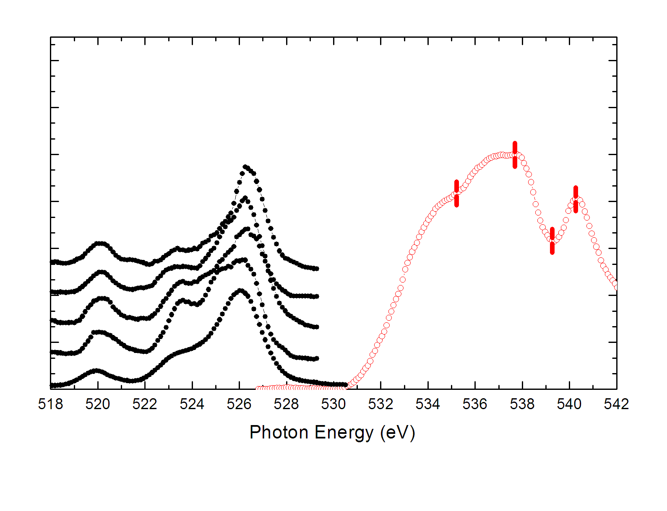
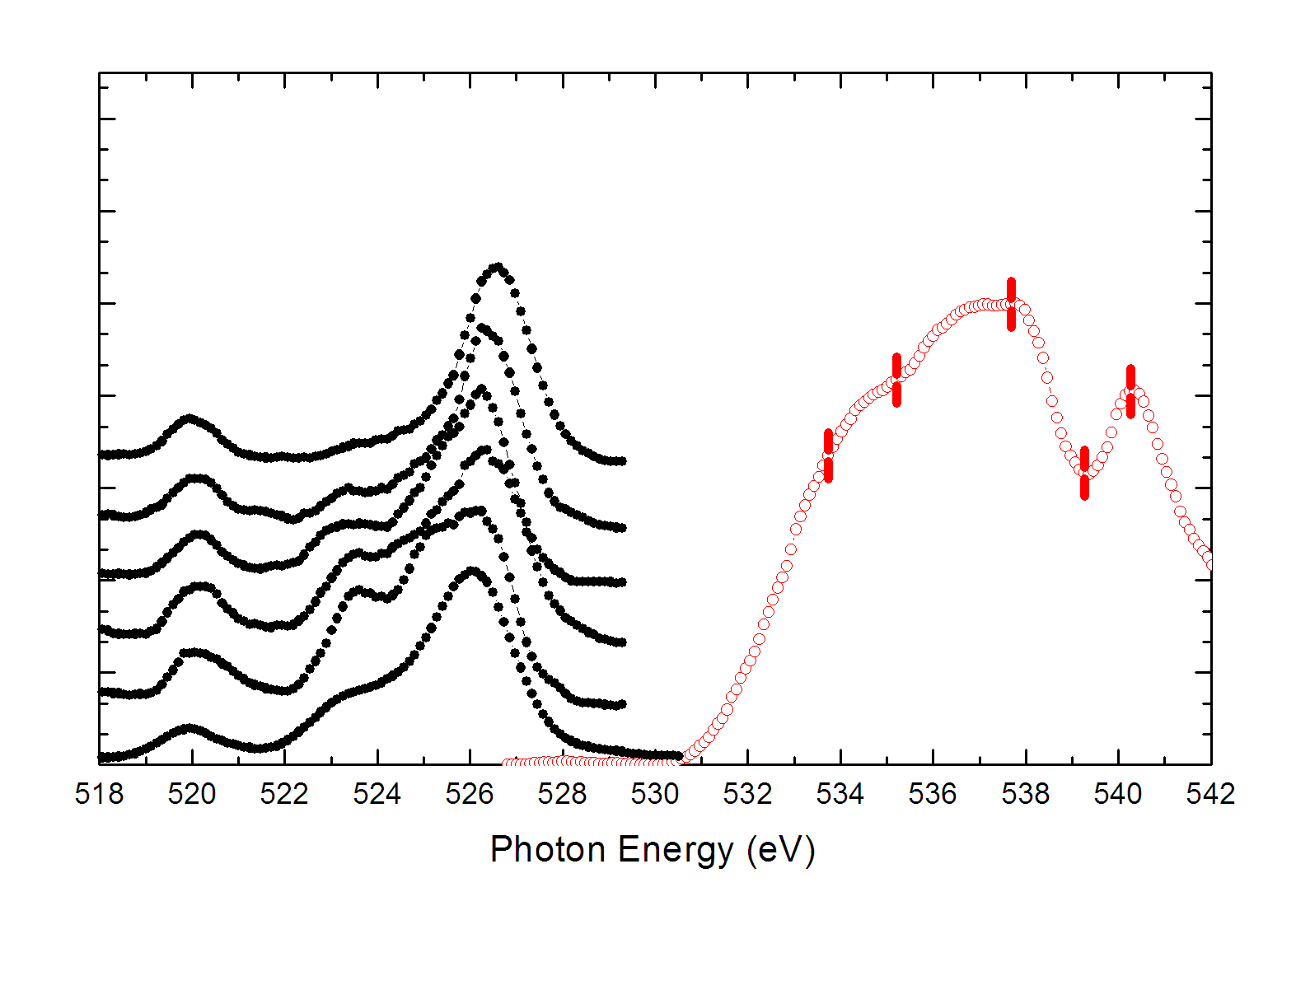
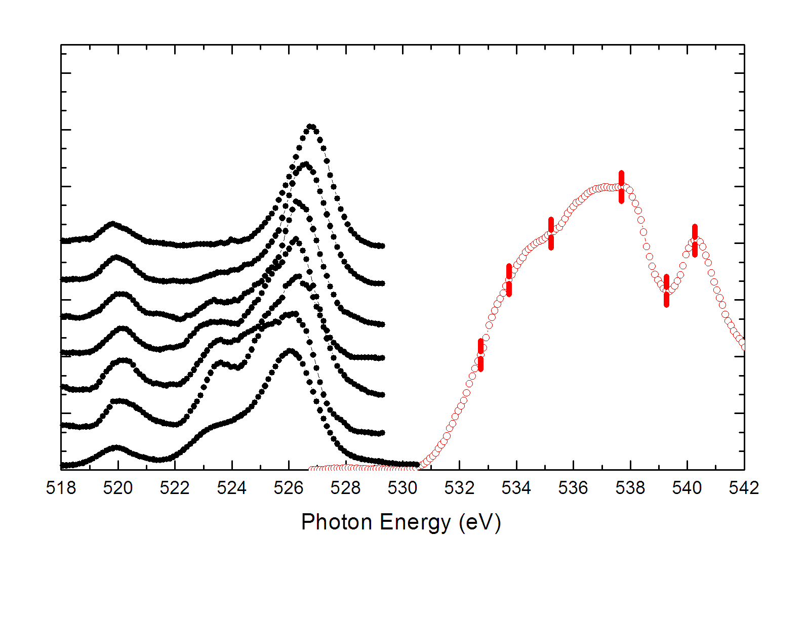
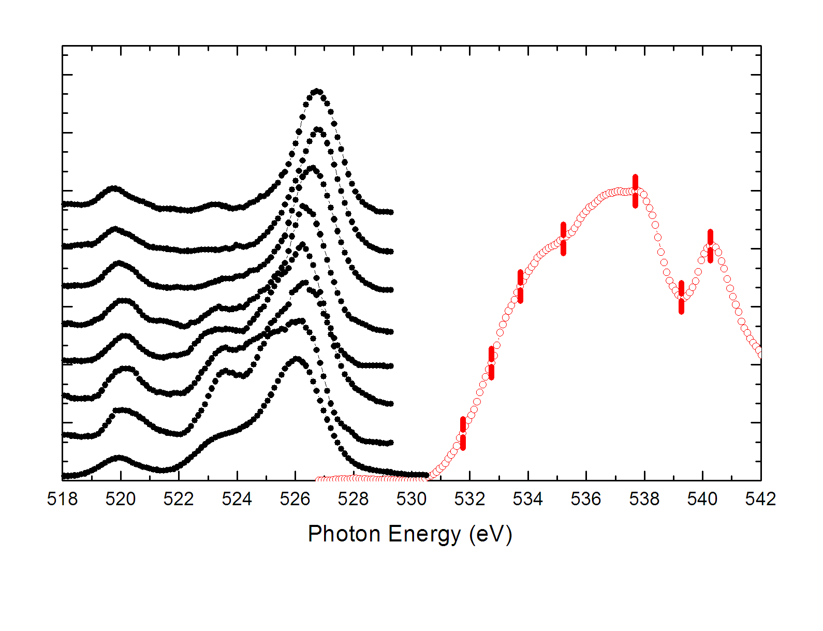
ZnO RXES

Slide 48
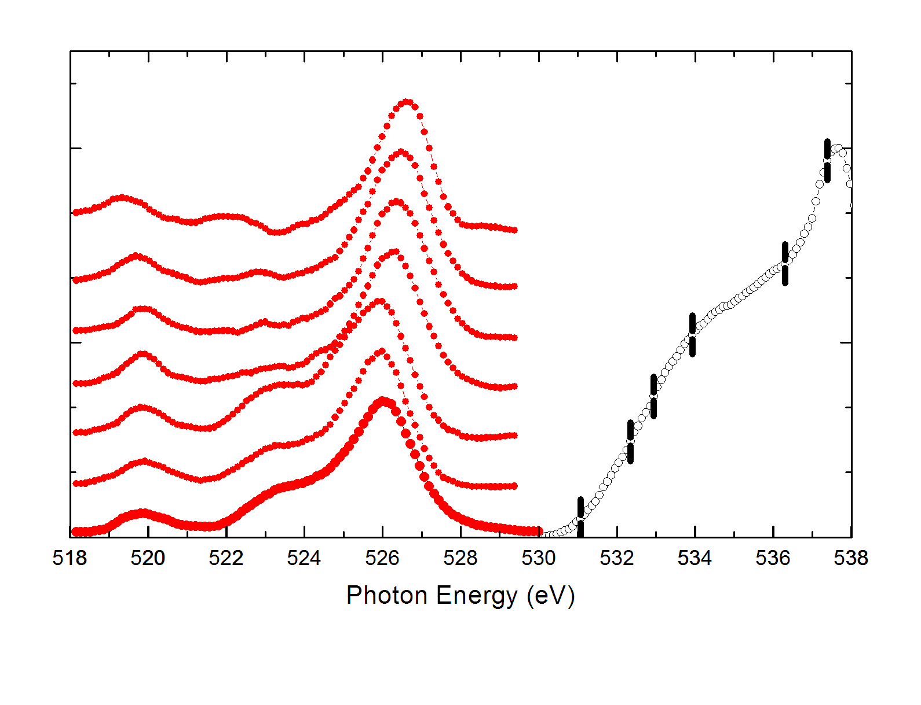
ZnO RXES

Slide 49
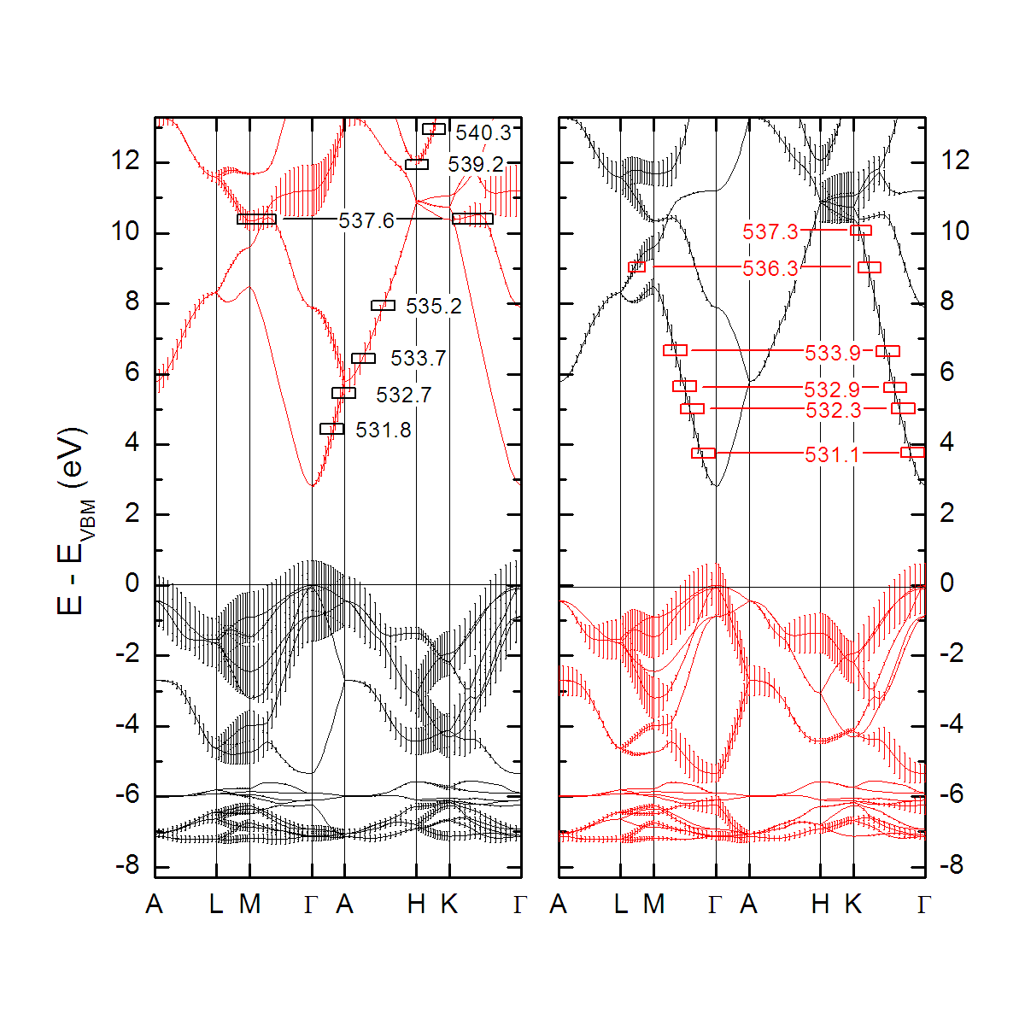
ZnO RXES

Slide 50
ZnO electronic structure

Slide 51
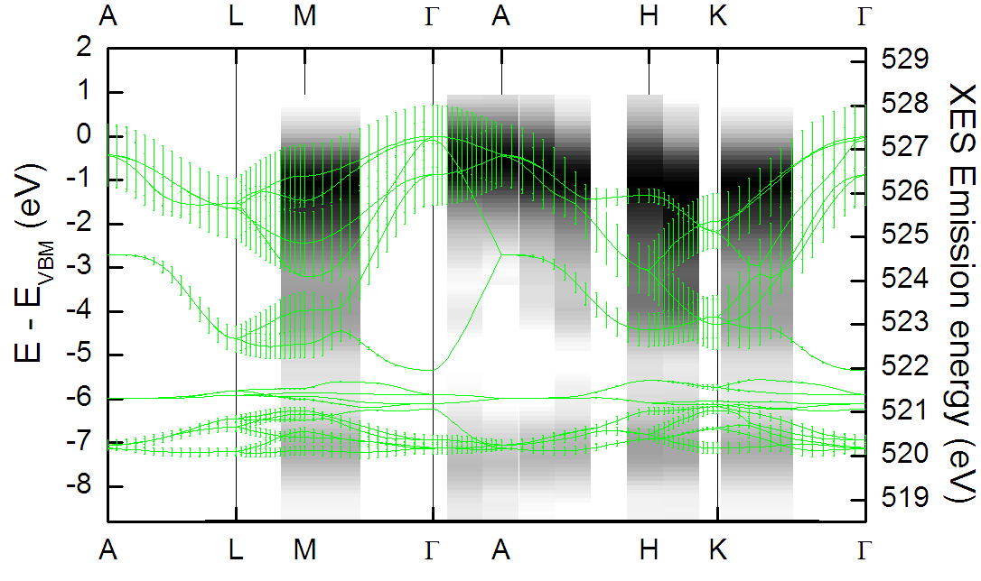
ZnO p_{xy} band structure

Slide 52
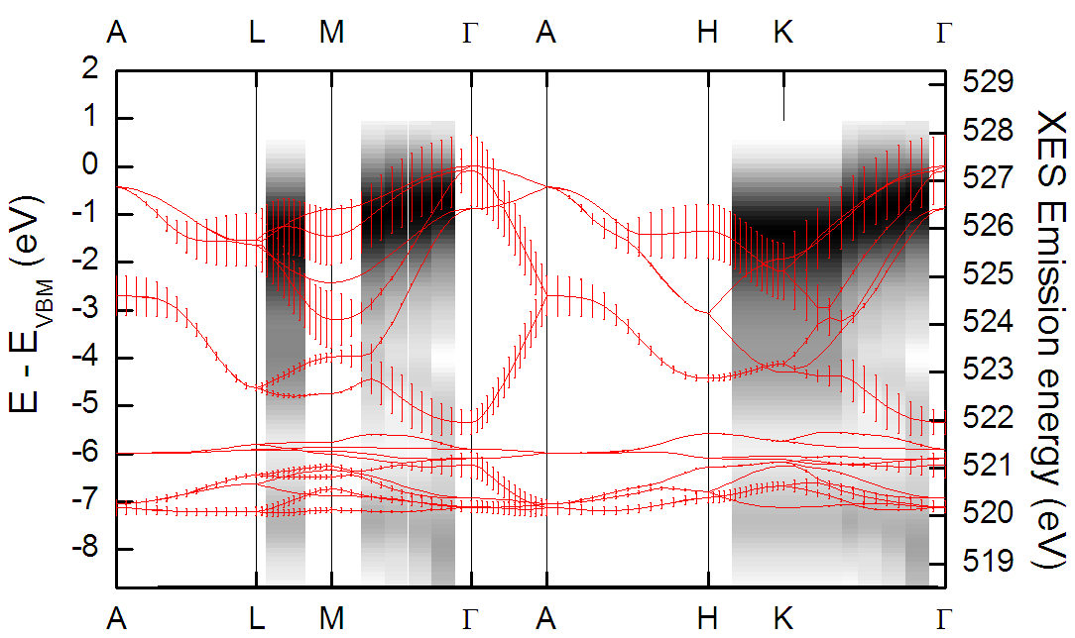
ZnO p_{z} band structure

Slide 53
Phys. Rev. B 78, 155114 (2008)
XAS, XES, and RXES to measure orbital resolved electronic structure and band dispersion
B. J. Ruck
Victoria University of Wellington
L. F. J. Piper, A. DeMasi, K. E. Smith
Boston University
A. Schleife, F. Fuchs, F. Bechstedt
Friedrich-Schiller-Universitat
J. Chai, S. M. Durbin
Canterbury University

Slide 54
Can we calculate the RXES?
andrew@preston.co.nz

Slide 55
X-ray photoemission (XPS)
Empty
E_{f}
Filled

Slide 56
X-ray photoemission (XPS)
Empty
E_{f}
Filled

Slide 57
Angle resolved XPS (ARPES)
Empty
E_{f}
E_{f}
Filled

Slide 58
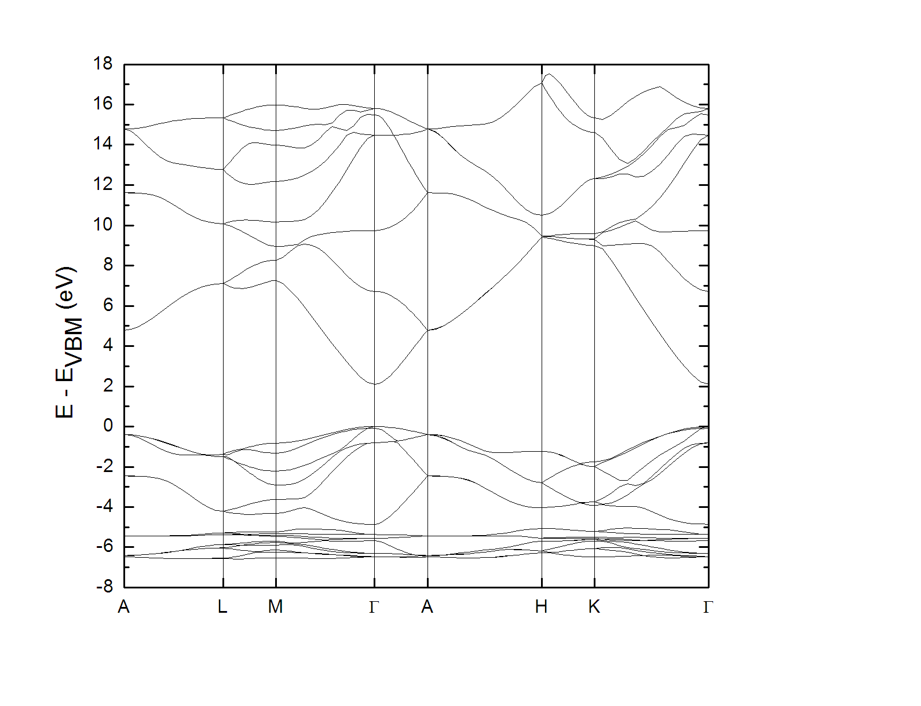
ZnO RXES

Slide 59
X-ray absorption (XAS)
Empty
E_{f}
Filled

Slide 60
X-ray emission (XES)
Empty
Filled

Slide 61
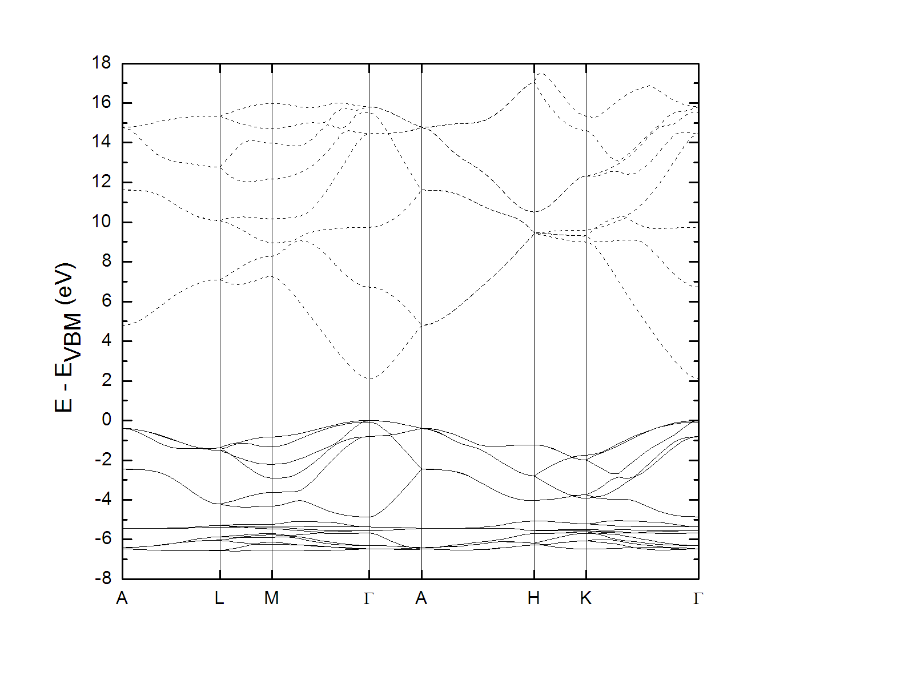
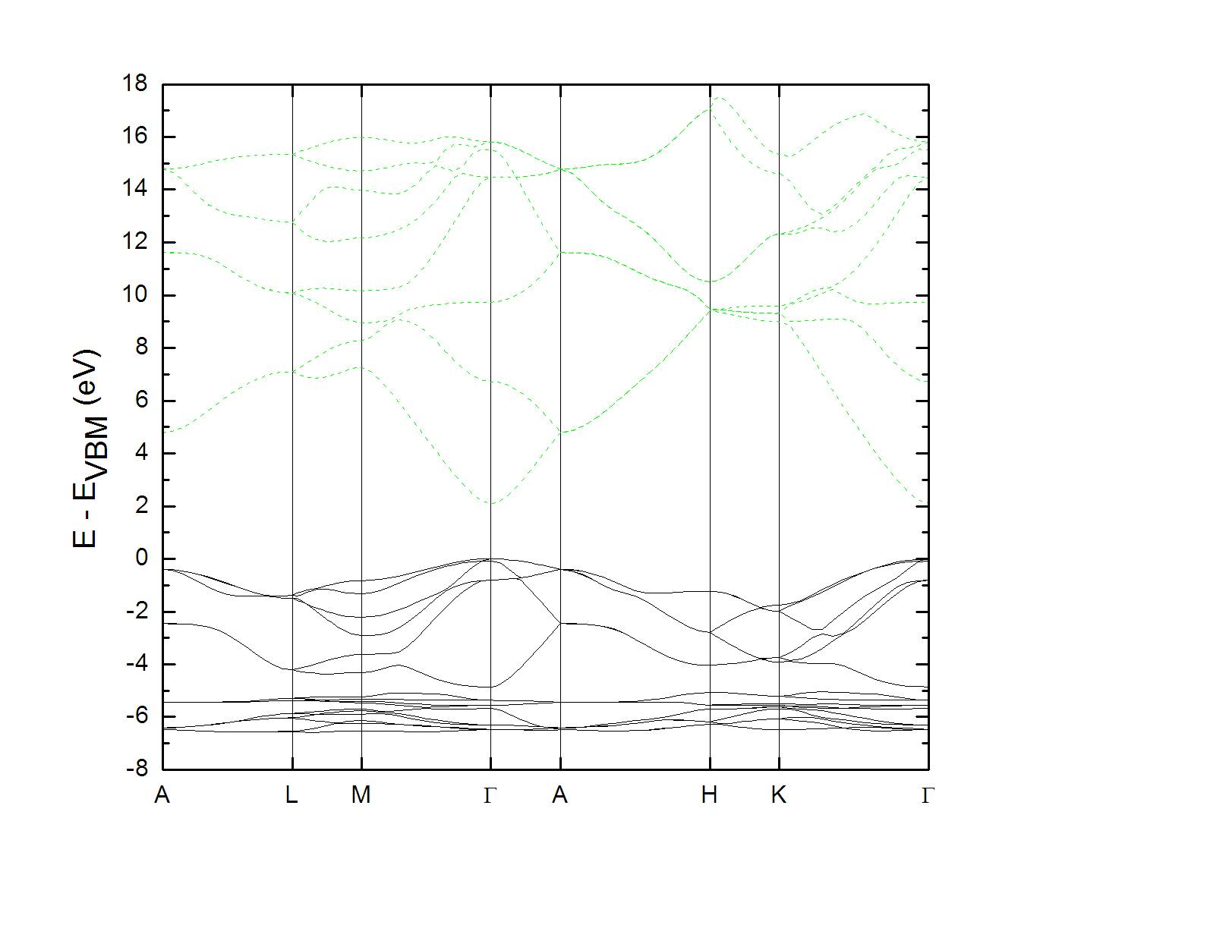
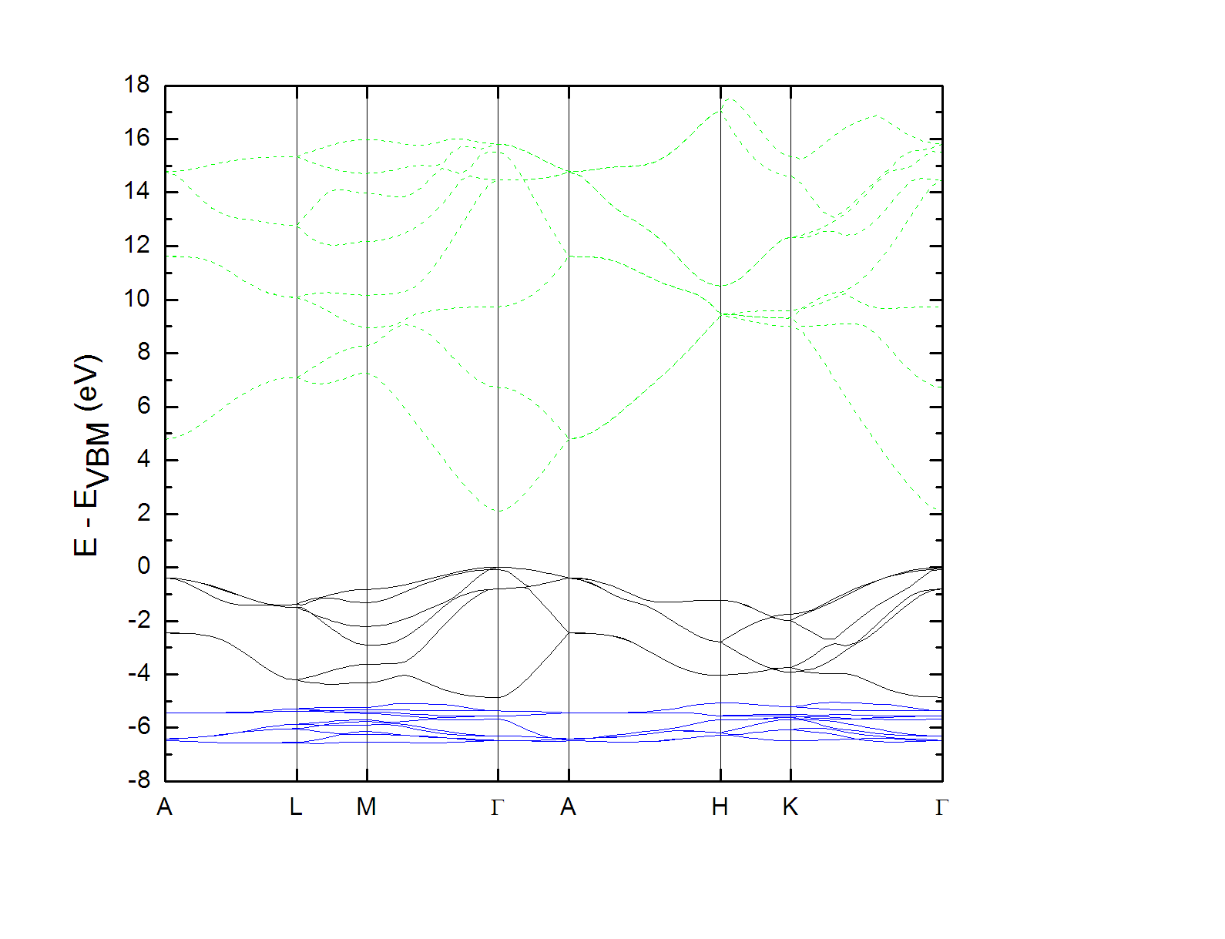
ZnO electronic structure
Quantum mechanics
Discrete states for energy eigenvalues
Crystalline material
Crystal momentum affects eigenvalues

Slide 62
Dipole approximation
Notes:
All about measuring transitions and inferring information about the QM system from them.
Optical transitions – dipole operator.
In our case we want to figure out band structure information.

Slide 63
Selection rules
Notes:
All about measuring transitions and inferring information about the QM system from them.
Optical transitions – dipole operator.
In our case we want to figure out band structure information.

Slide 64
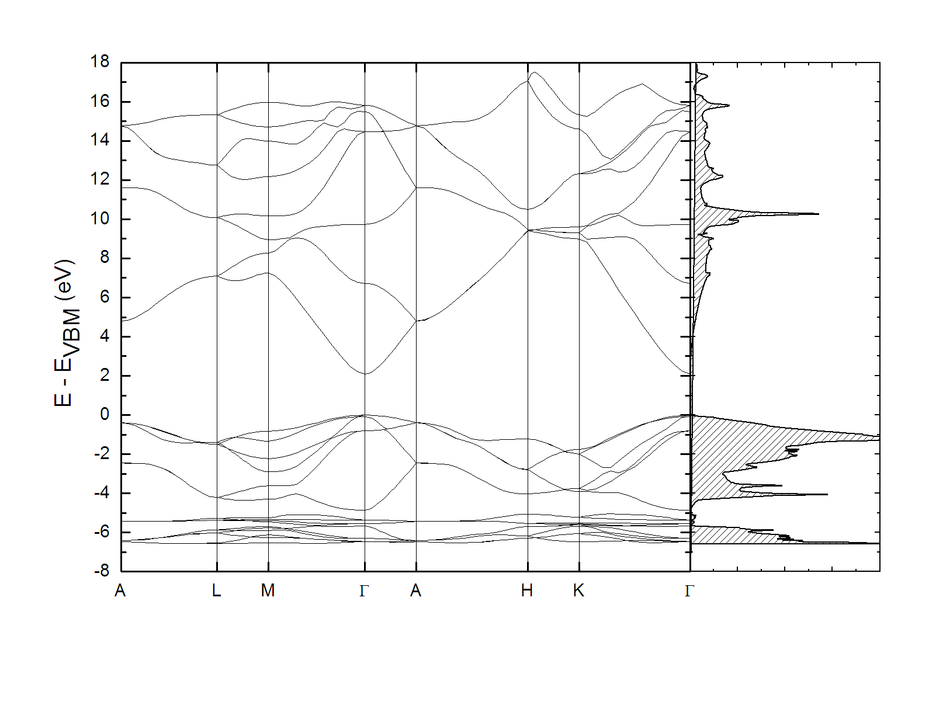
ZnO electronic structure

Slide 65
Resonant XES

